Slide 1

Animal bites analysis Louisville, Kentucky
By Prakash Parajuli email: prakashparajuli2046@gmail.com

Slide 2
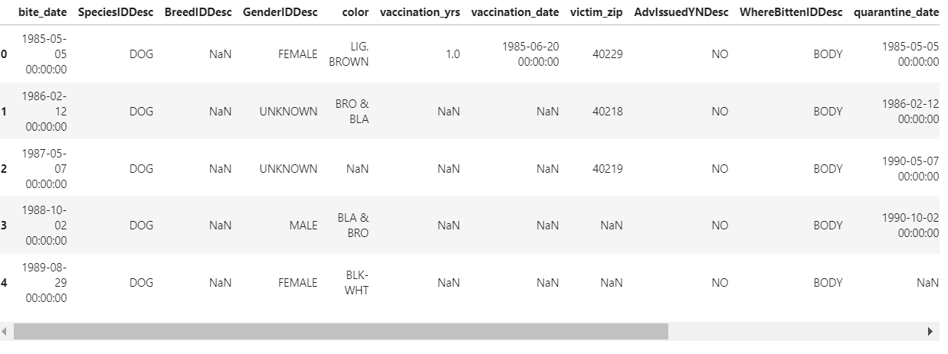

Slide 3
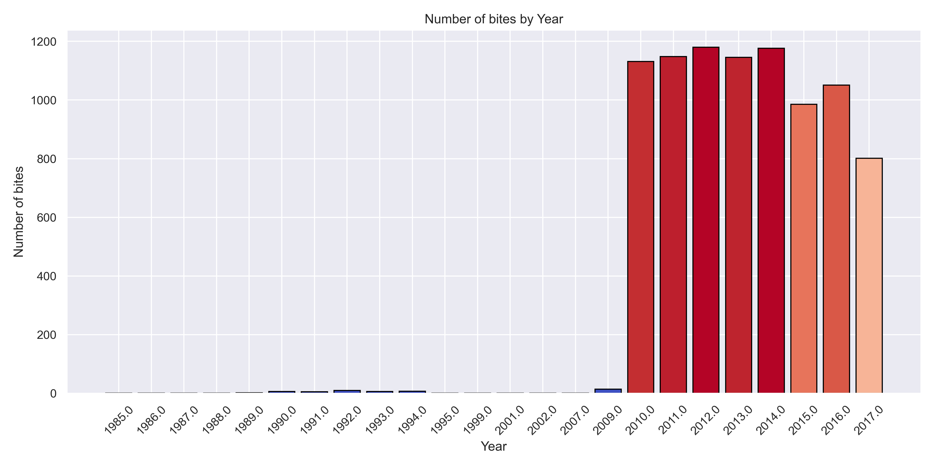
Factors Contributing to Animal Bites?
Month of the year
Day of the week
Population
Species of animal
Breed of the animal
Gender of the animal

Slide 4
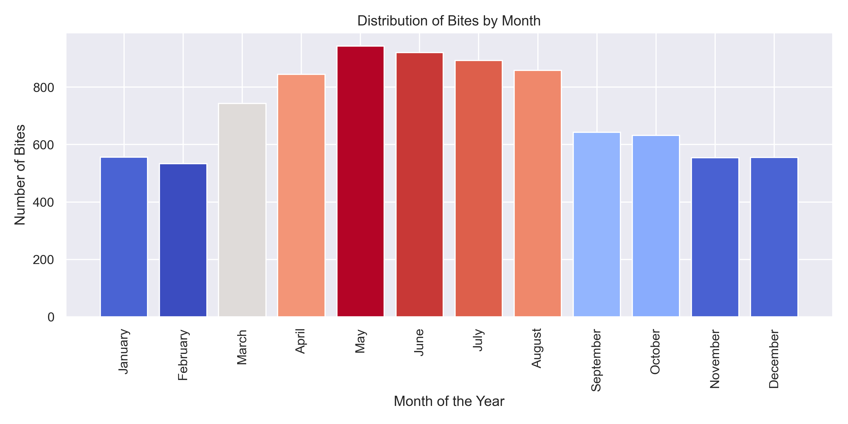
Month of the year
Highest number of animal bites occurs in May (943 bites)
Summer month has higher animal bites
Human activities during these seasons like vacations.

Slide 5
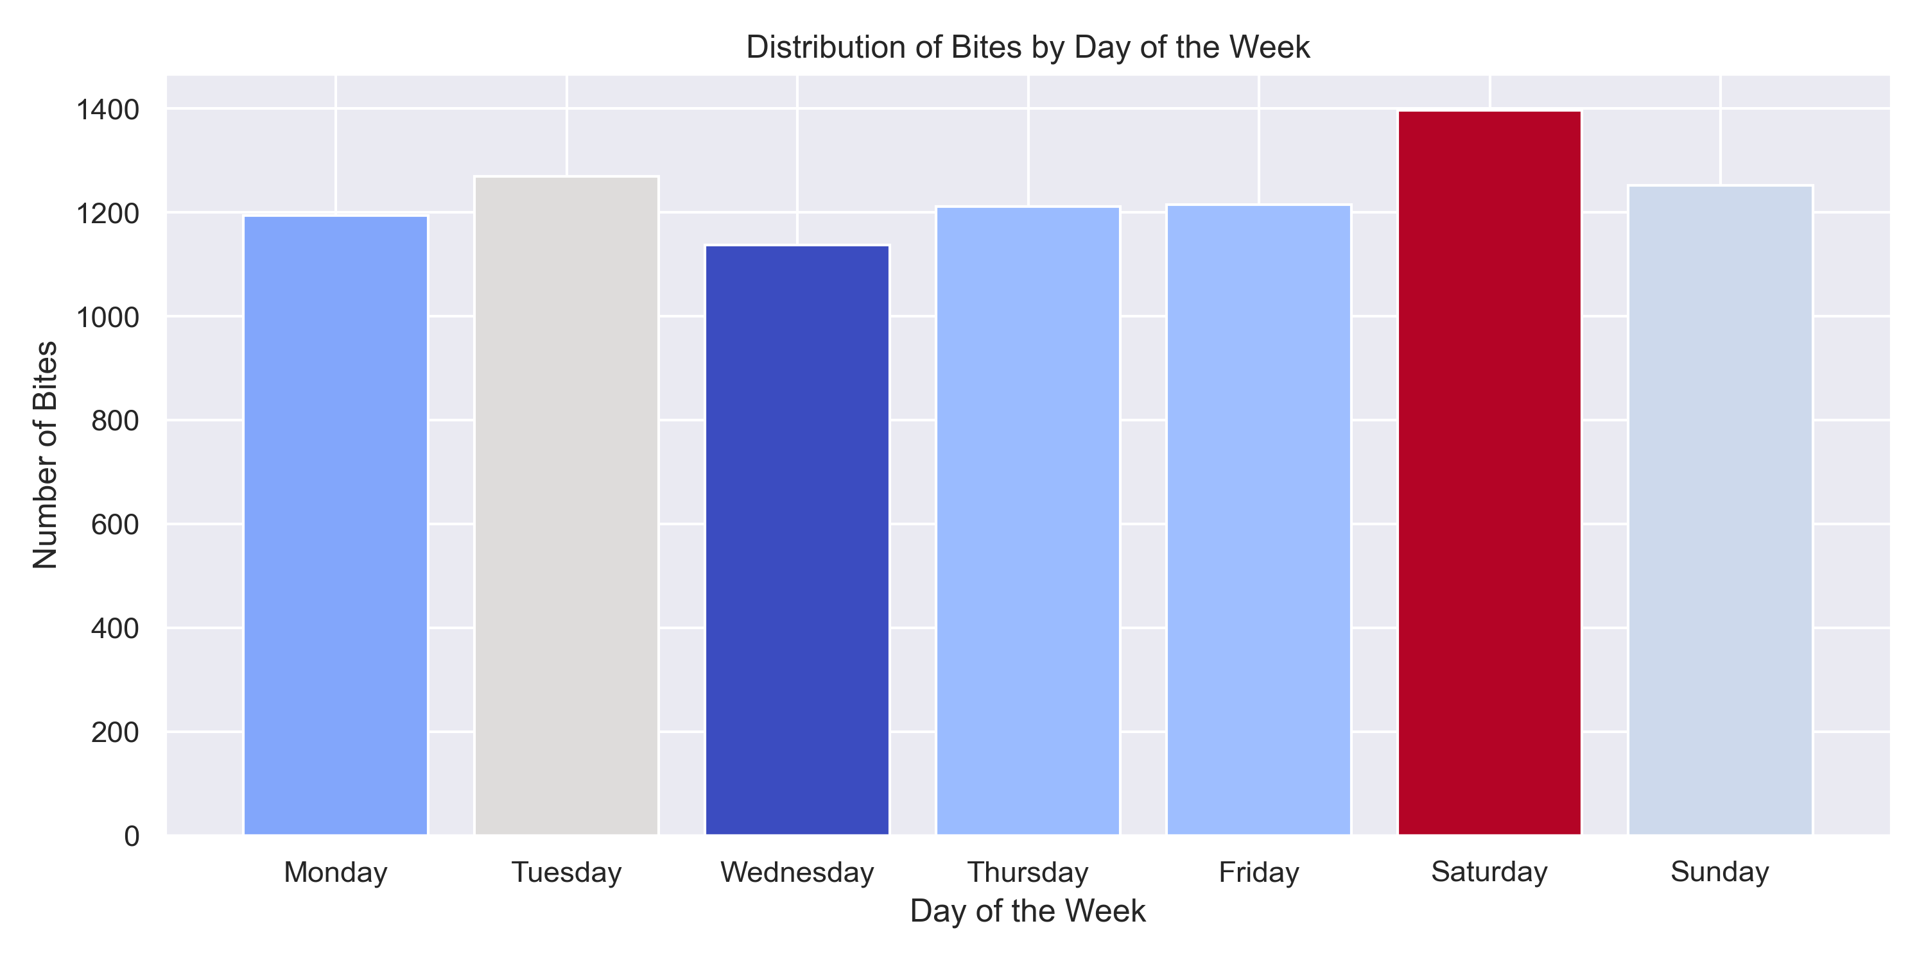
Day of the week
Saturday has the highest number of animal bites (1397)
Weekday vs. Weekend Trends.
Increased outdoor activities or interactions with animals causes more animal bites.

Slide 6
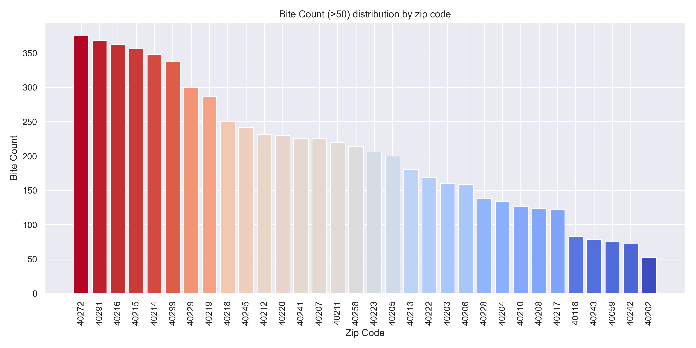
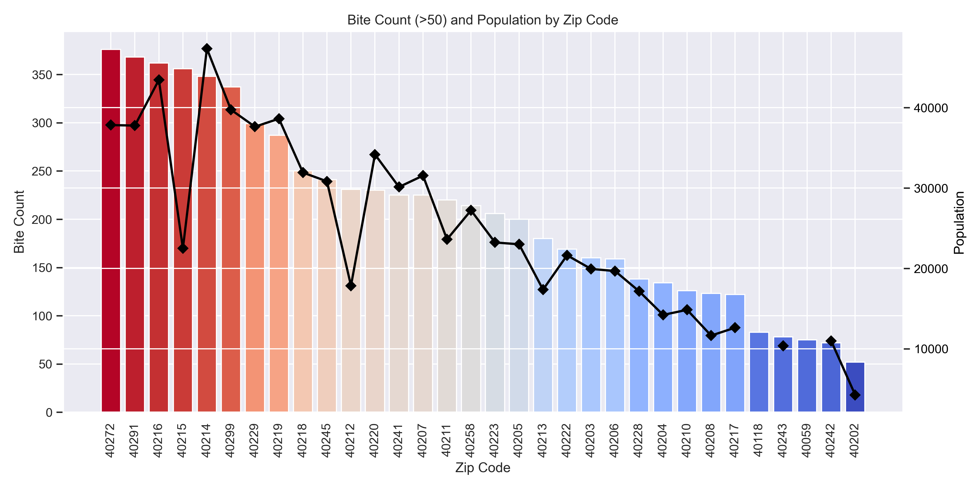
Zip code population: Two anomalies

Slide 7
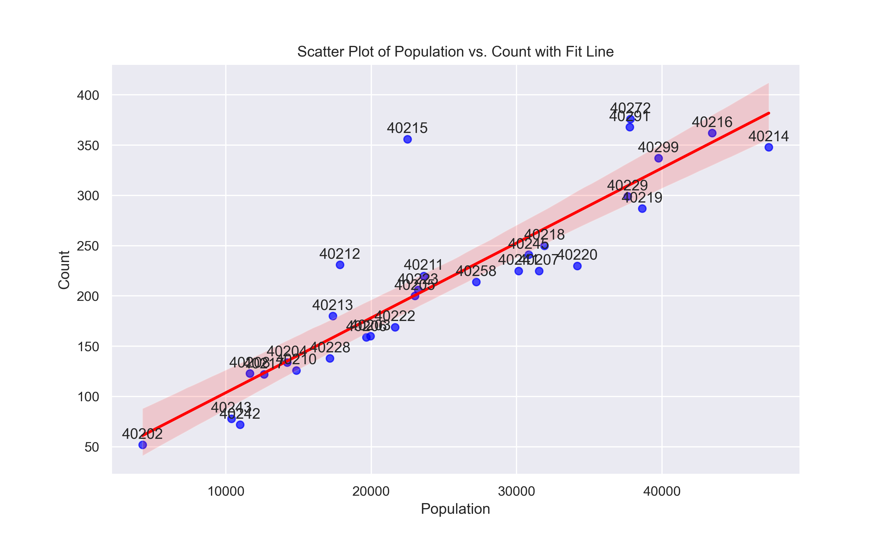
Zip code population: Two anomalies

Slide 8
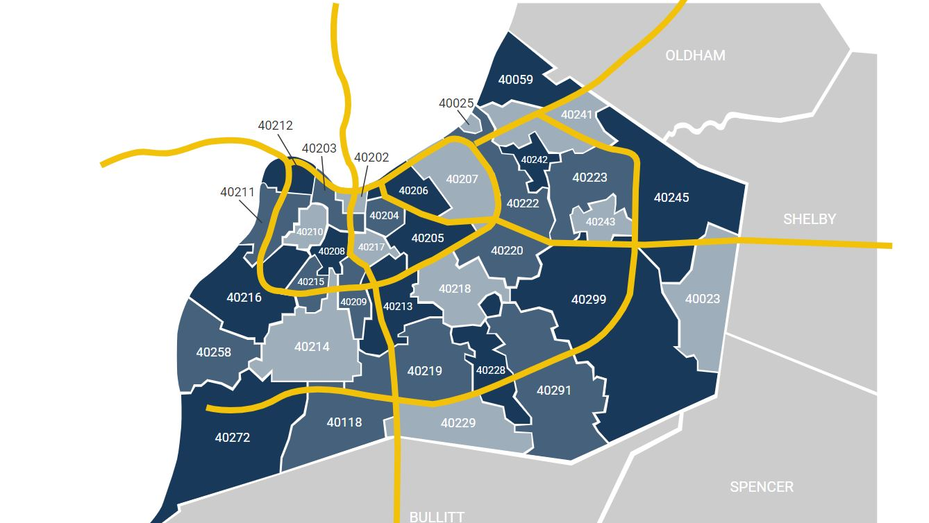
Zip code population: Two anomalies

Slide 9
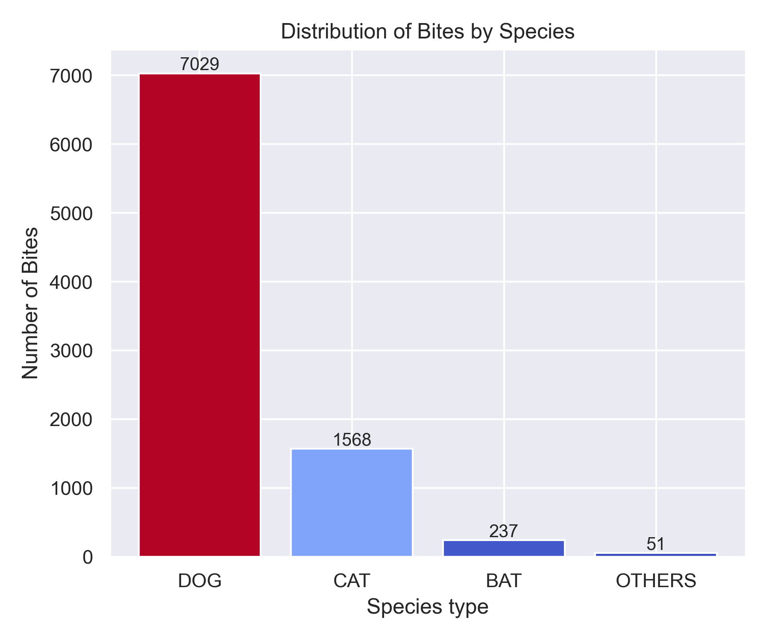
Species of animal
Dogs represent the largest concern for animal bite prevention efforts, with over 80%.
Cats, while less frequent, still contribute significantly.
Bats and other species are less common

Slide 10
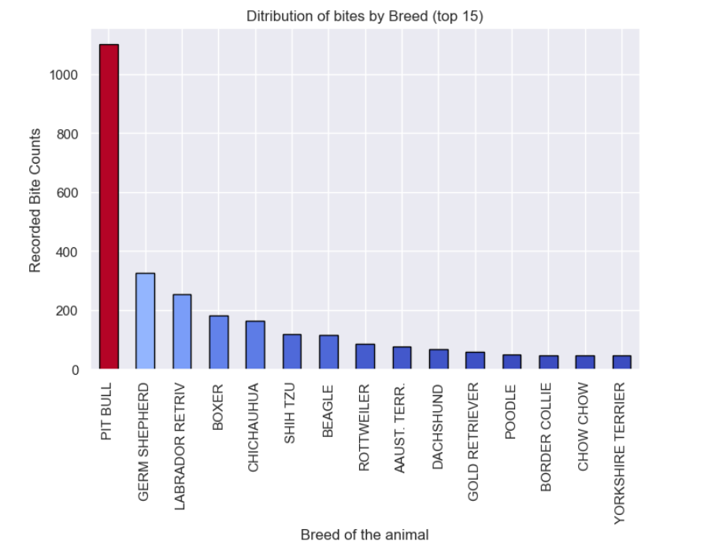
Breed of animal
Pit Bulls are disproportionately represented in bite incidents compared to other breeds.
Other breeds like German Shepherds and Labrador Retrievers also show notable bite cases.
Even small breeds like Chihuahuas are responsible for bites

Slide 11
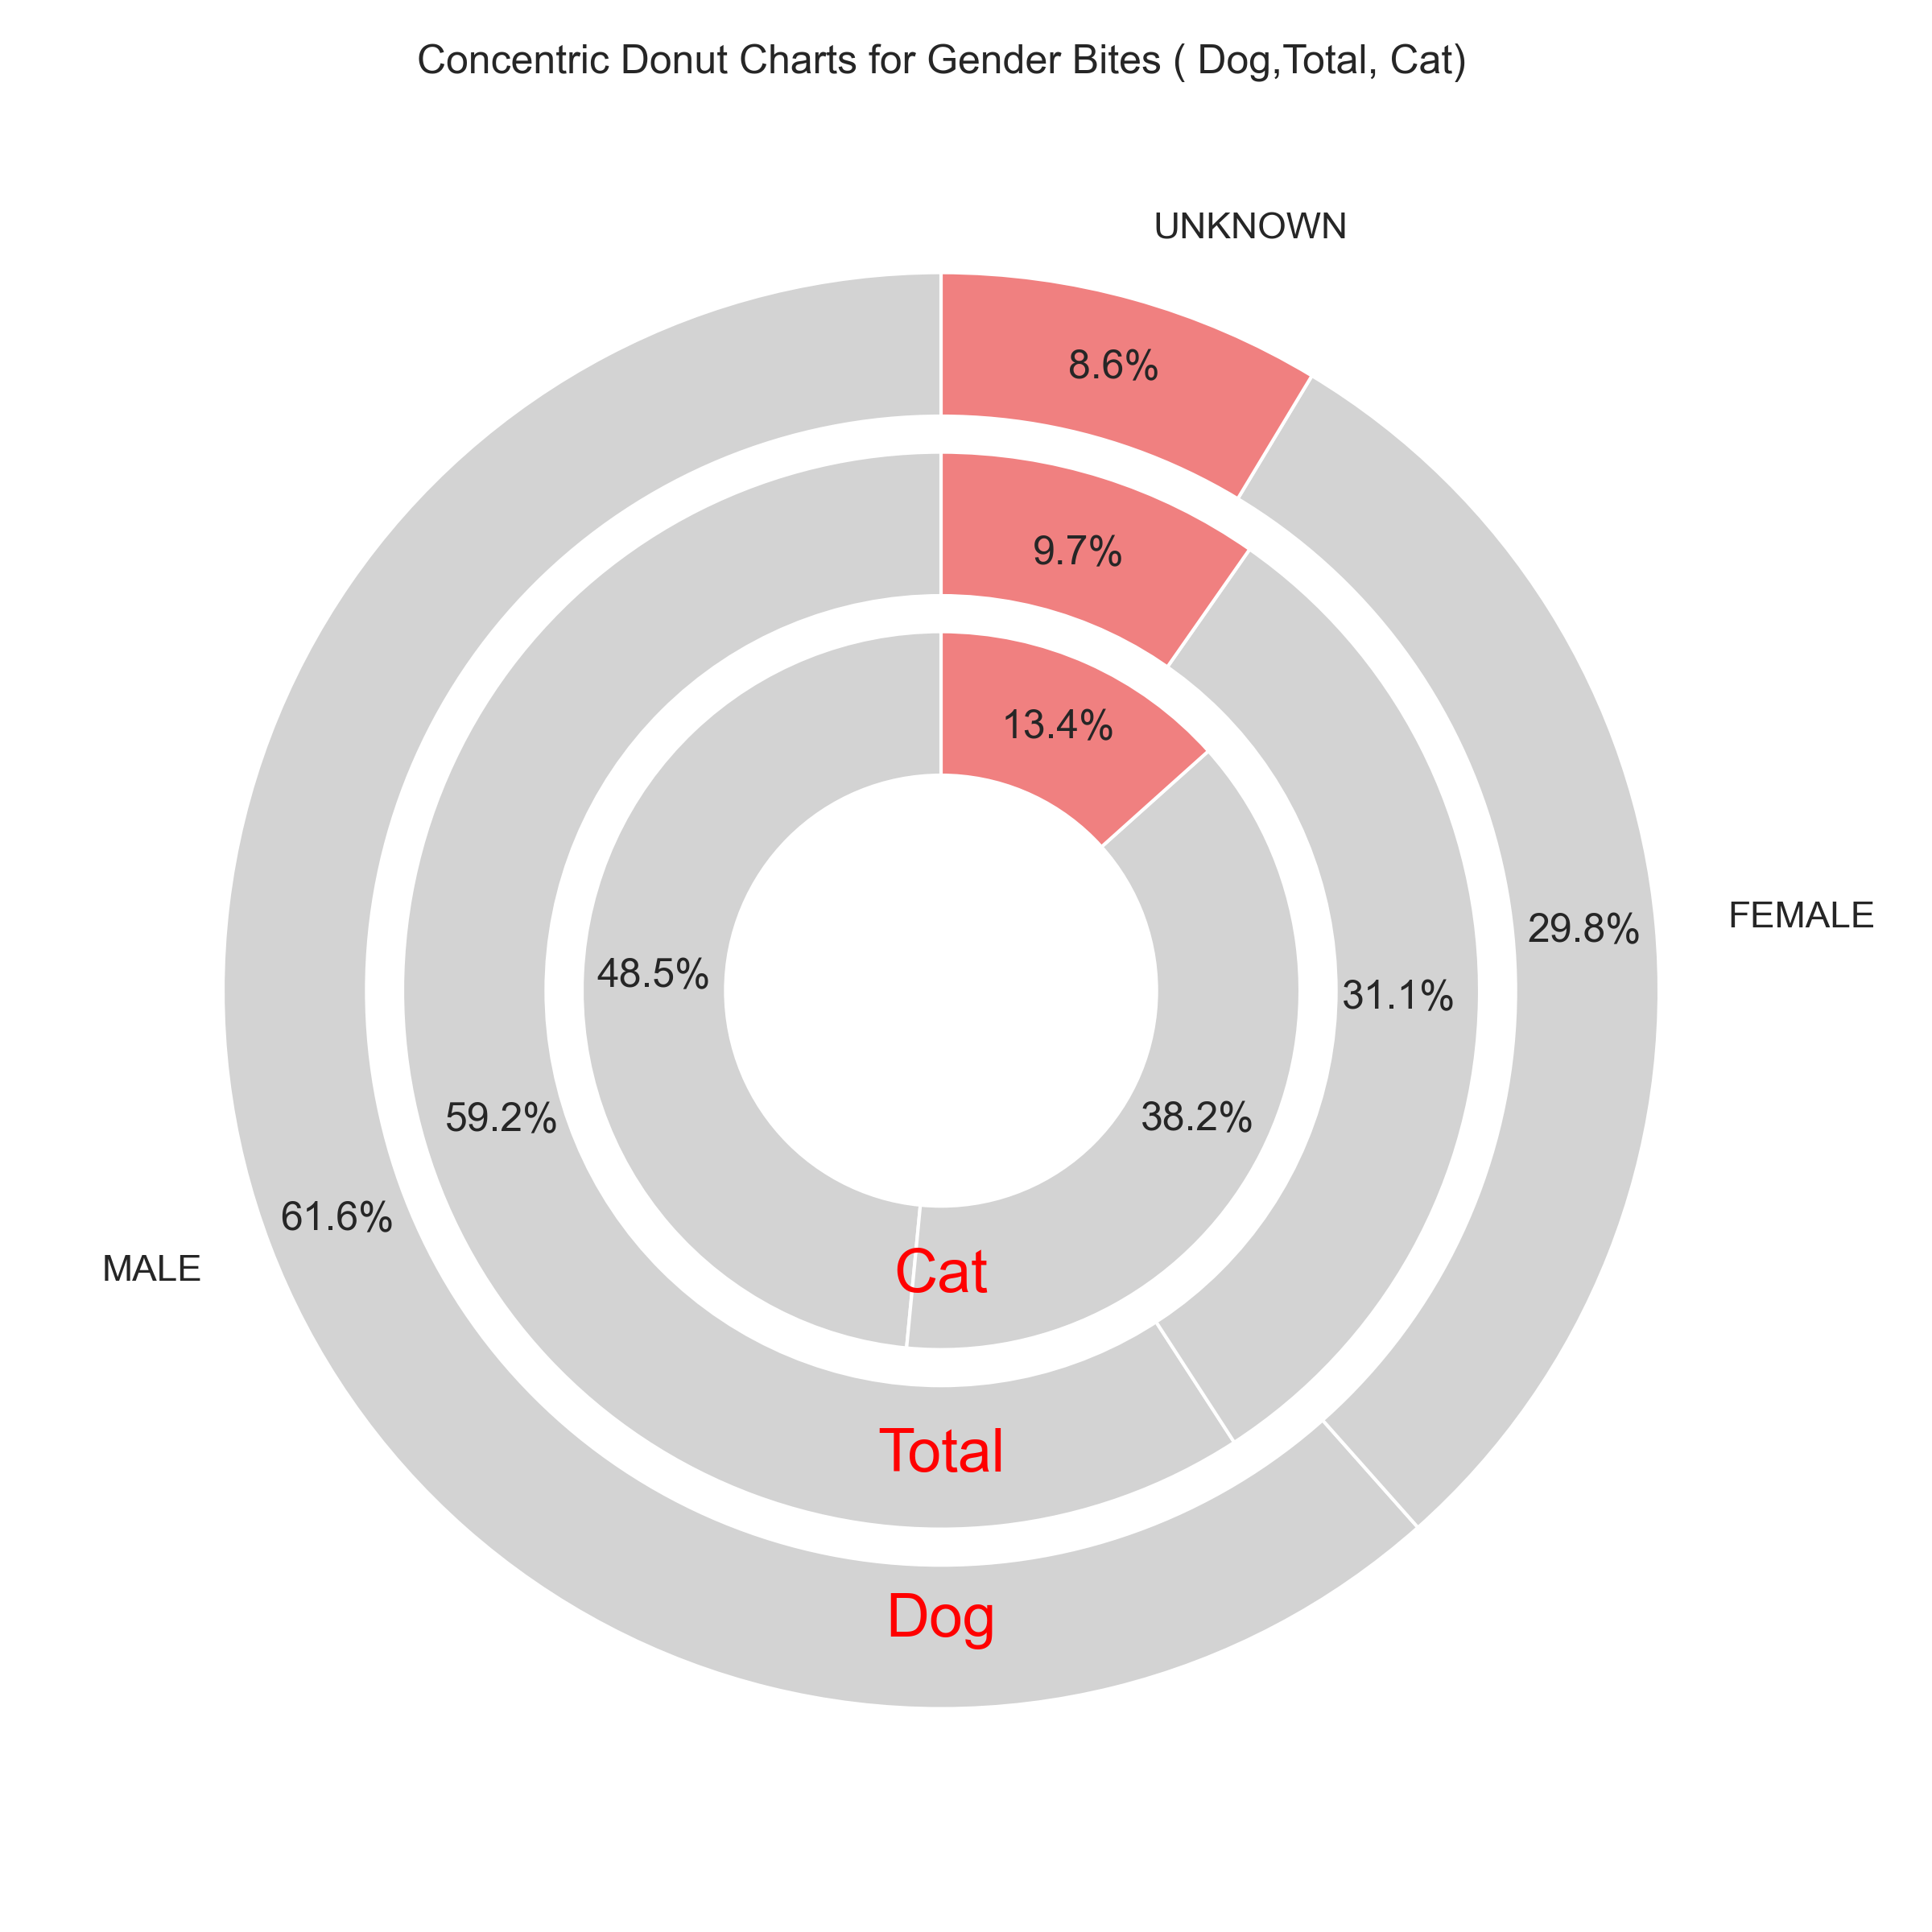
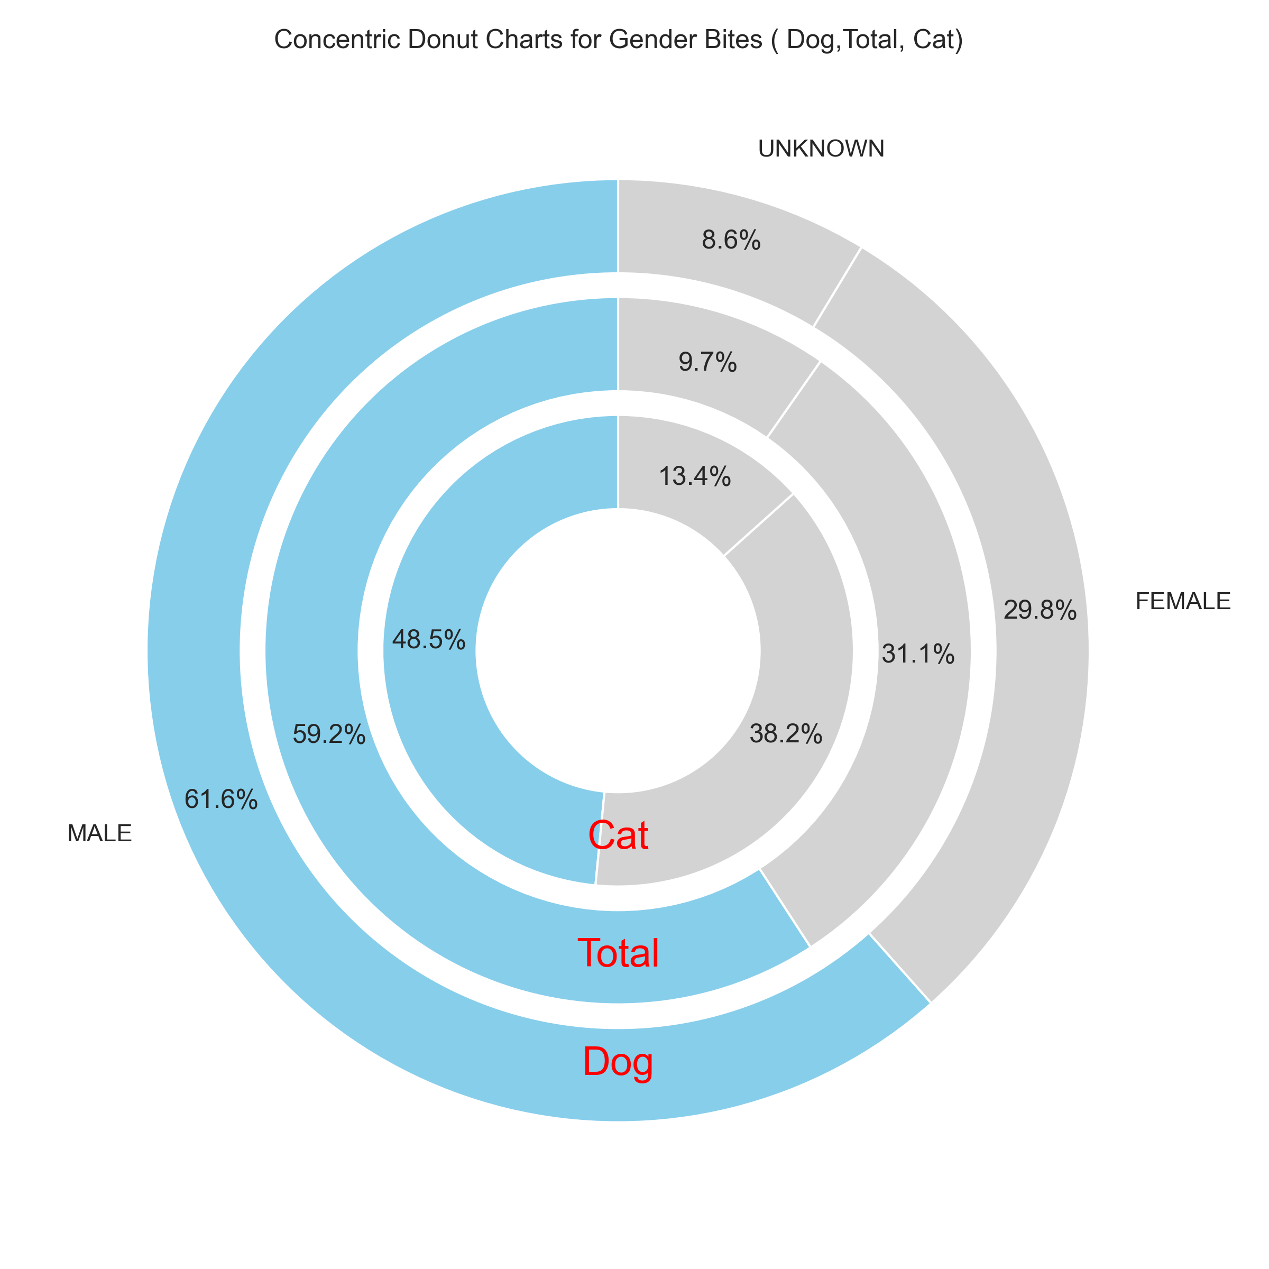
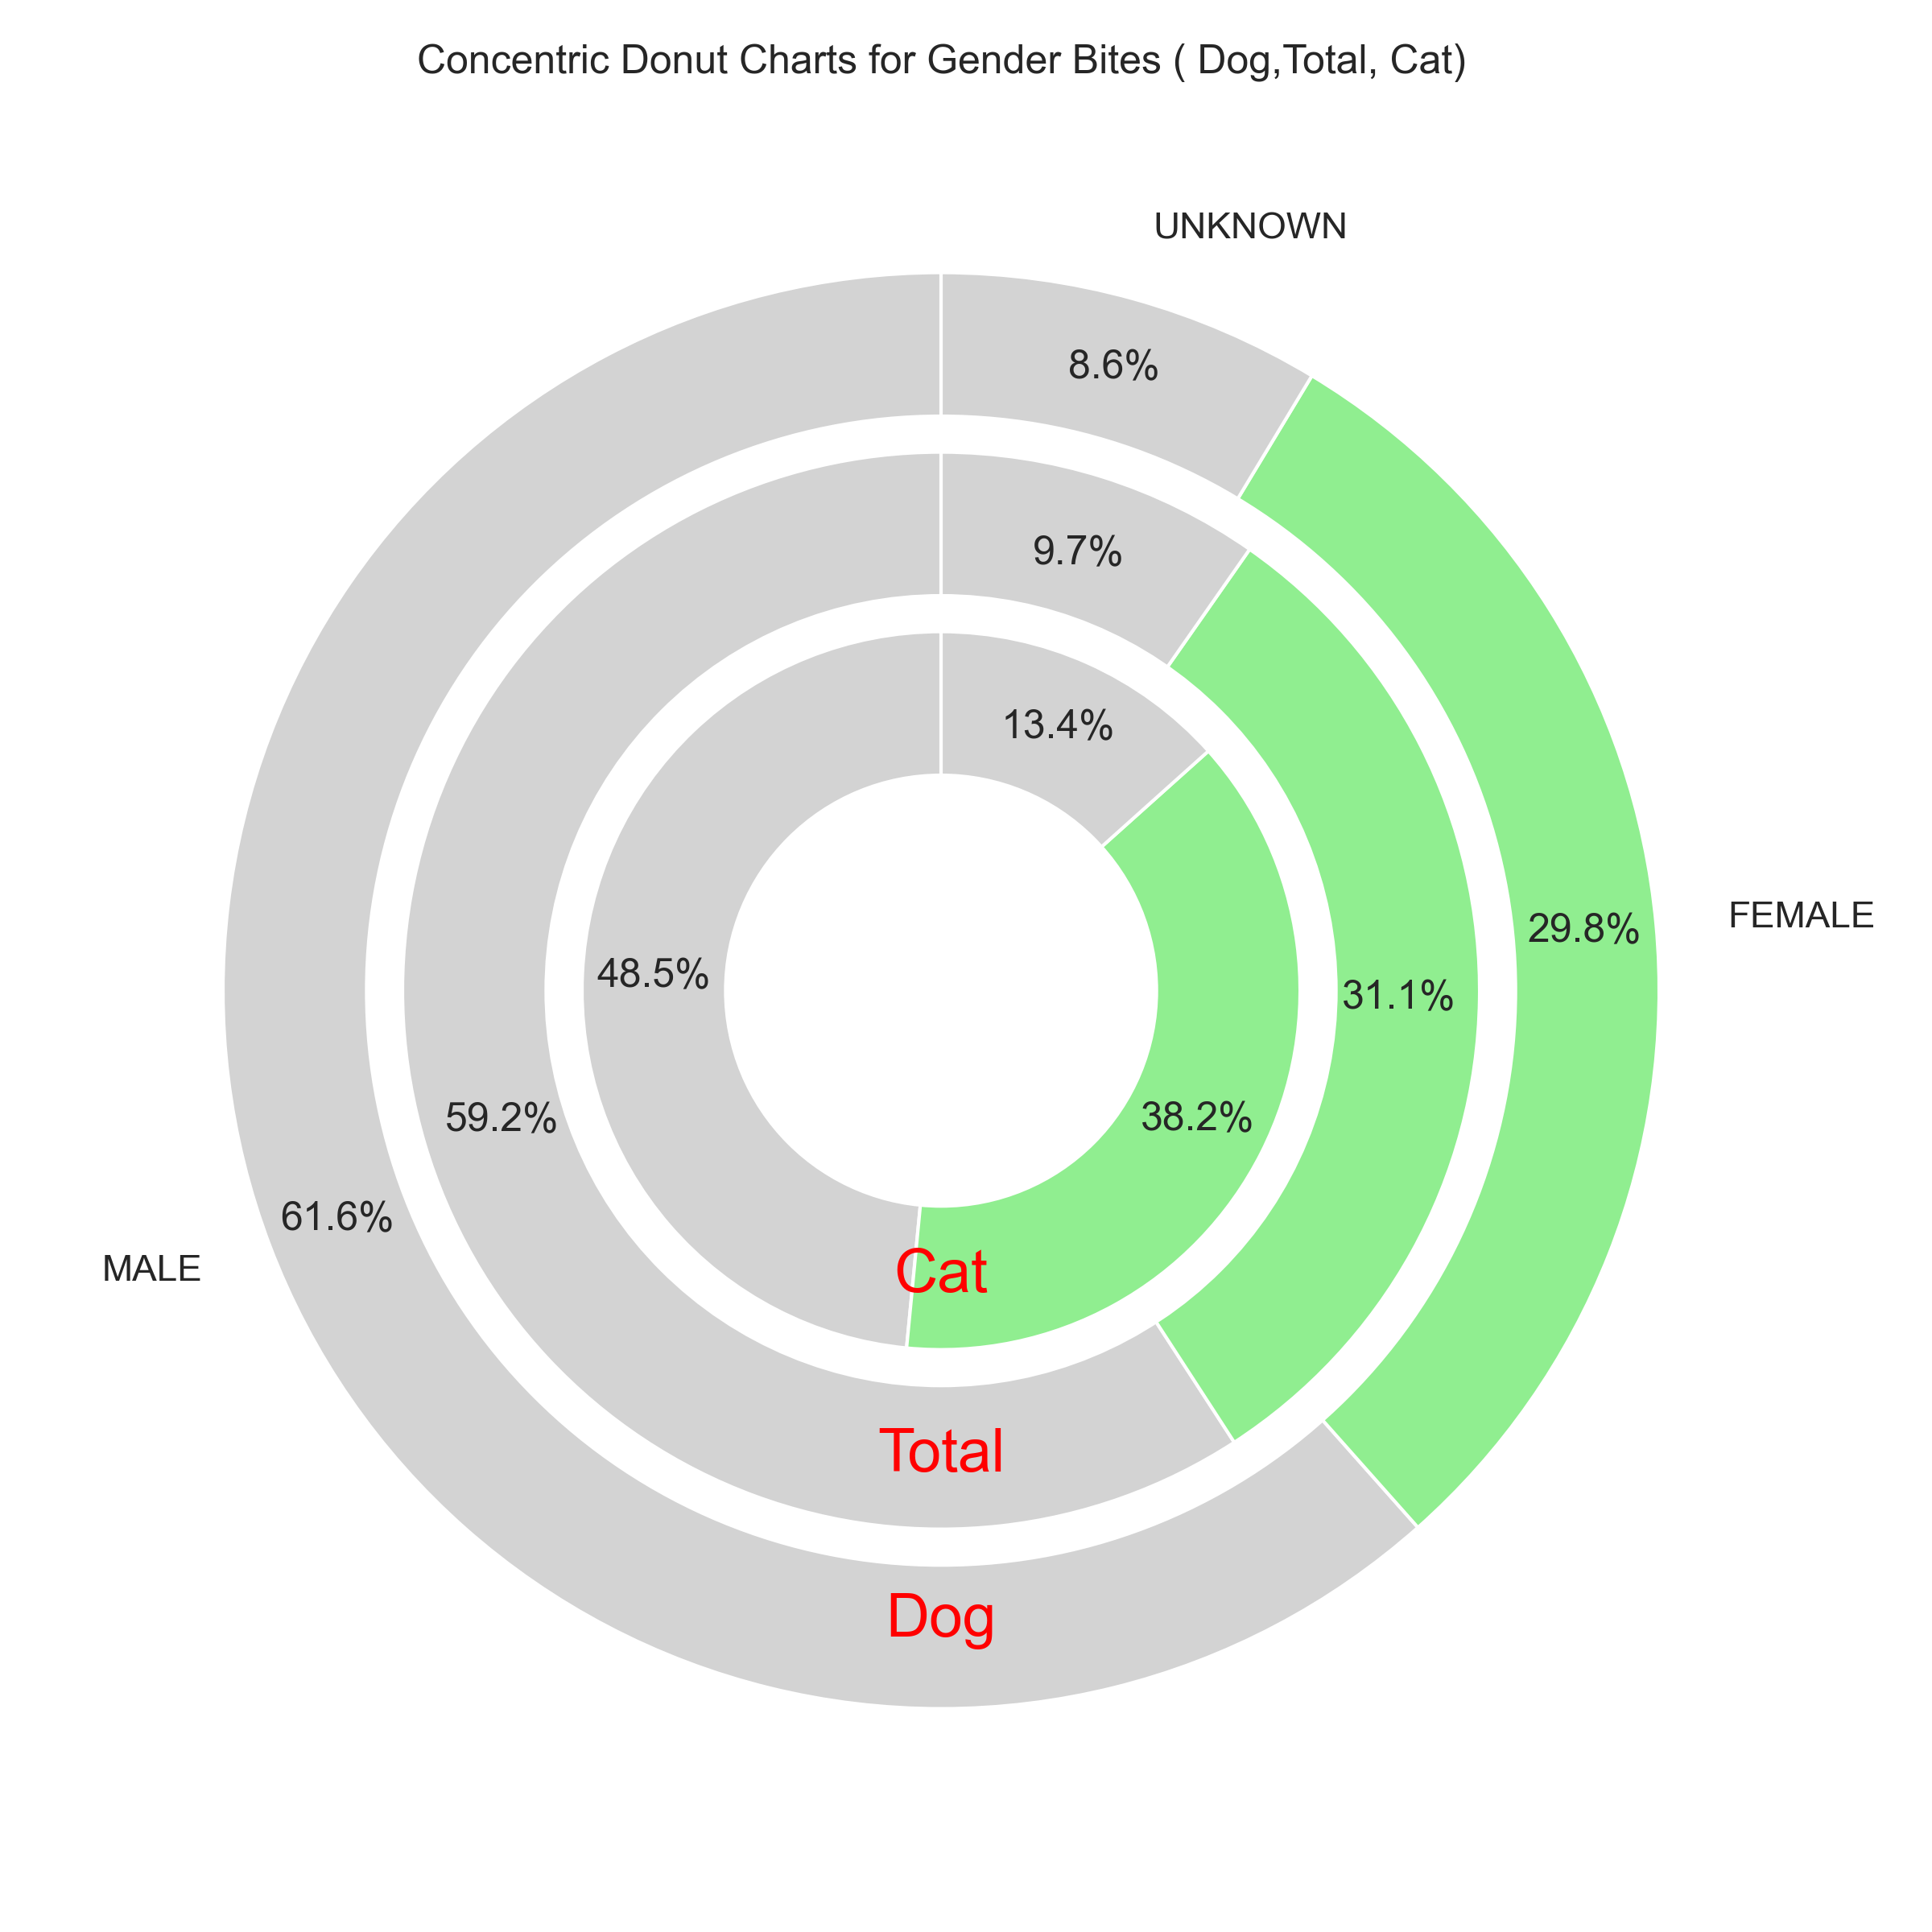
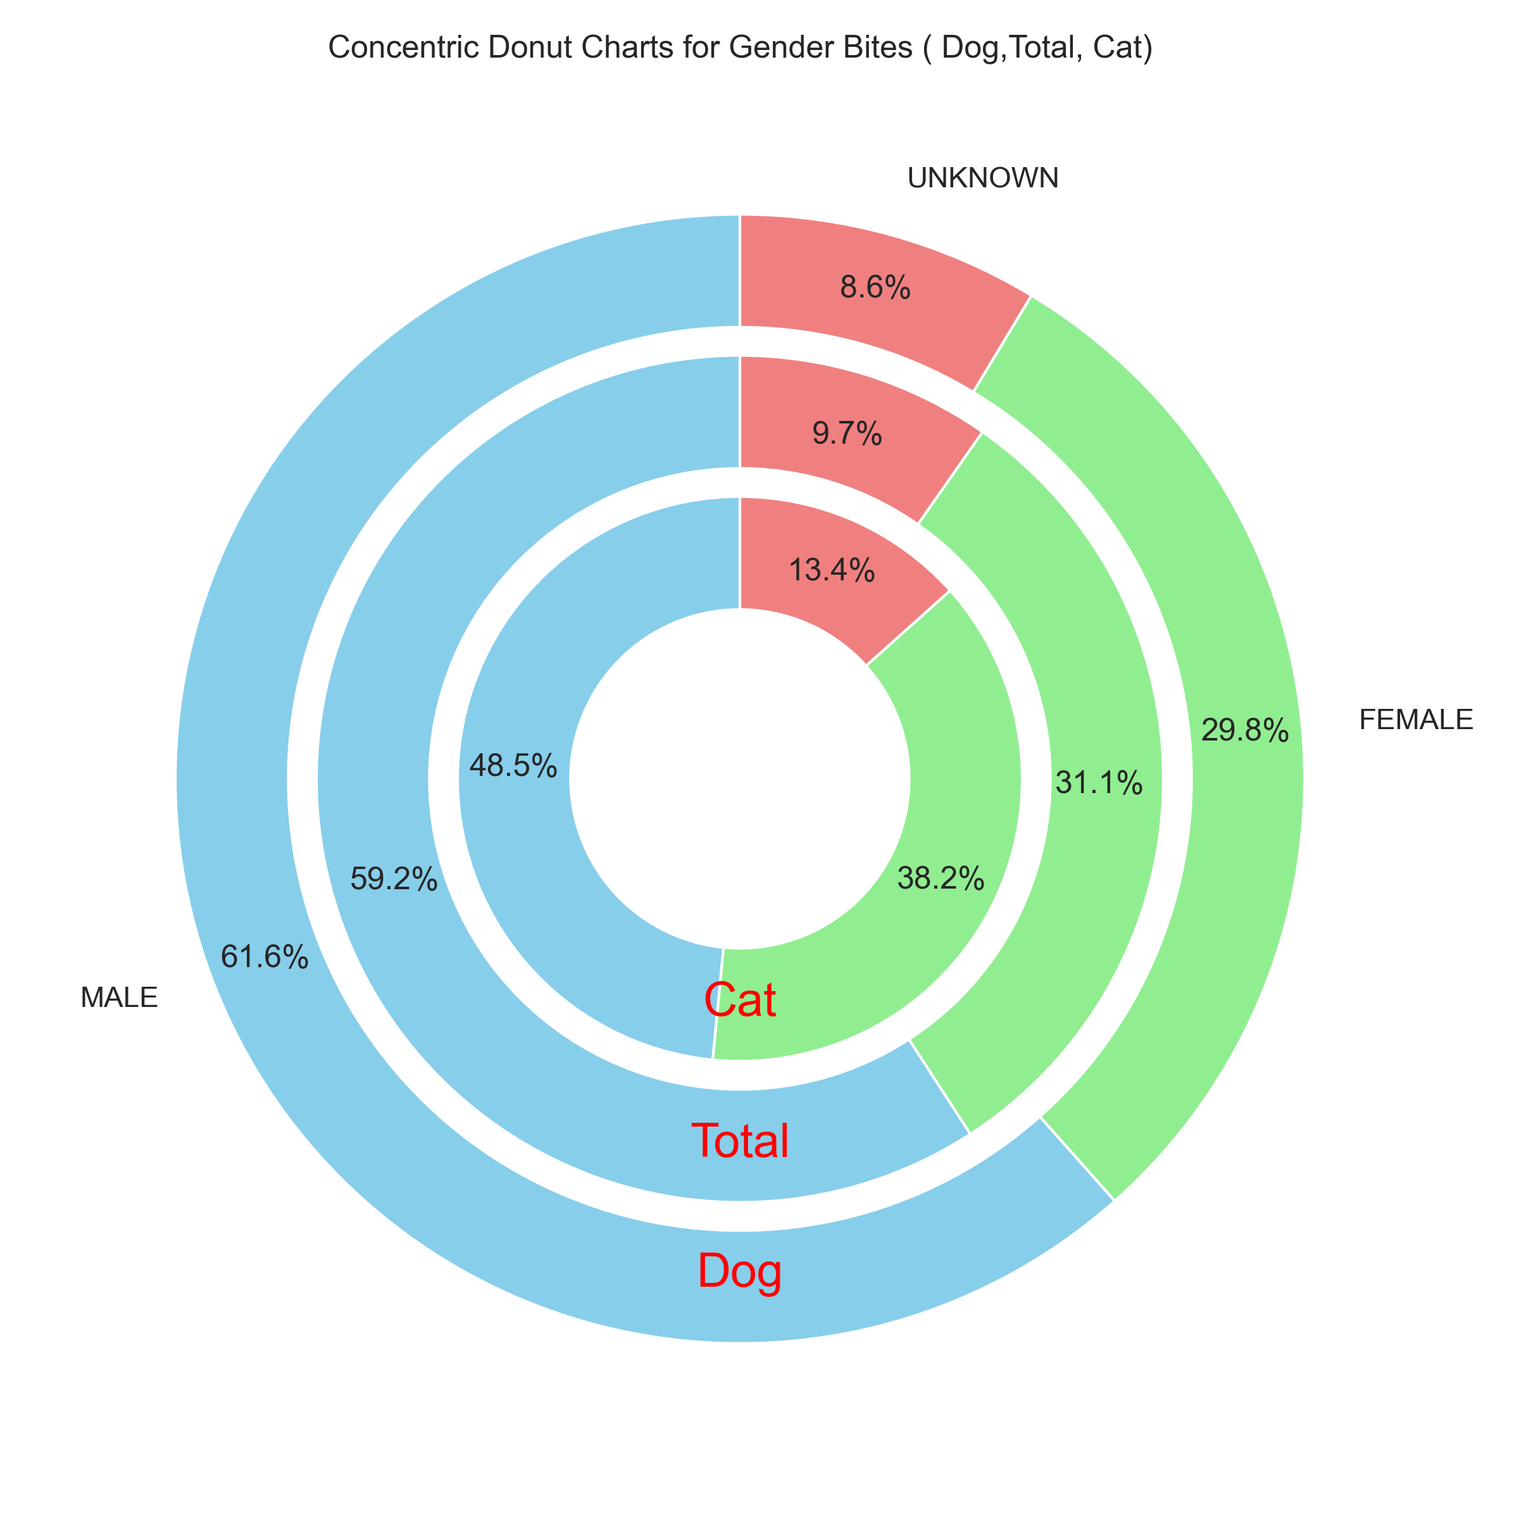
Gender of the animal
Males are involved in significantly more animal bite incidents overall.
The gender difference in cat bites is smaller compared to dogs.
Female cats are relatively more likely to bite compared to female dogs

Slide 12
Conclusions
Seasonal and Day-of-the-Week Patterns: Animal bites are more frequent during summer months and on weekends, particularly on Saturdays.
Population and Animal Bites Correlation: There is a strong correlation between zip code population size and the number of animal bites, though certain areas show unexpected trends.
Dogs as the Primary Source of Bites: Dogs are responsible for the vast majority of bite incidents, with certain breeds disproportionately represented.
Gender Differences in Bite Incidents: Males are involved in more animal bites overall, but the gender difference is smaller in cat bites compared to dog bites.

Slide 13
Future work
Species | Total | Vaccinated | Unvaccinated | sent for test | vaccinated but tested positive | Vaccinated and tested negative | Unvaccinated and tested positive | Unvaccinated but tested negative
DOG | 7029 | 3212 | 3817 | 59 | 0 | 2 | 1 | 56
CAT | 1568 | 522 | 1046 | 64 | 0 | 0 | 0 | 64
BAT | 237 | 0 | 237 | 163 | 0 | 0 | 3 | 160
RACCOON | 27 | 0 | 27 | 9 | 0 | 0 | 0 | 9
OTHER | 11 | 0 | 11 | 5 | 0 | 0 | 0 | 5
HORSE | 5 | 1 | 4 | 0 | 0 | 0 | 0 | 0
FERRET | 4 | 2 | 2 | 0 | 0 | 0 | 0 | 0
RABBIT | 3 | 0 | 3 | 0 | 0 | 0 | 0 | 0
SKUNK | 1 | 0 | 1 | 0 | 0 | 0 | 0 | 0

